Slide 1
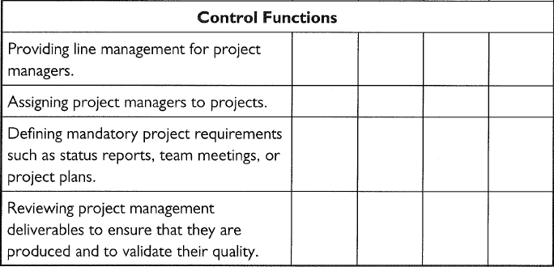
RESPONSIBILITIES FOR PO FUNCTIONS

Slide 2
SAMPLE: RESPONSIBILITY MATRIX

Slide 3
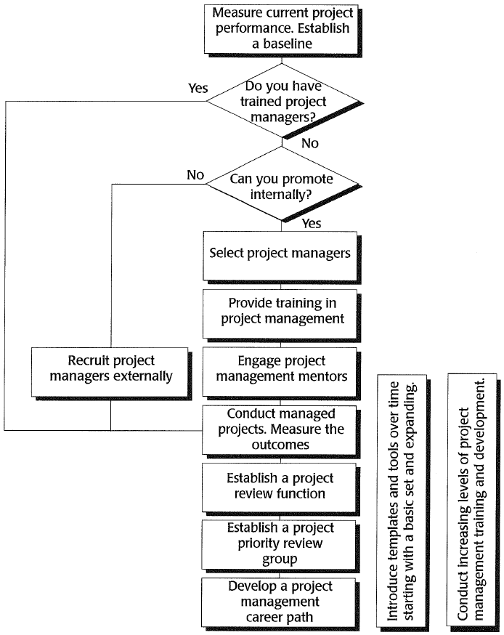
Road map to setting up PMO

Slide 4
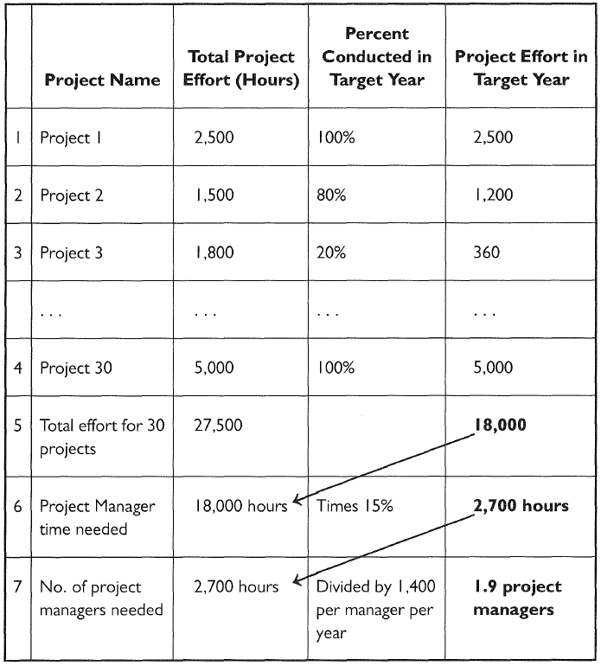
NUMBER OF PM NEEDED

Slide 5
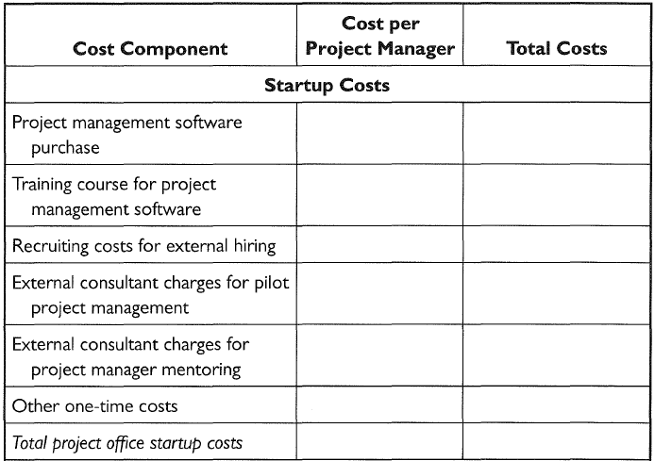
COST OF A PROJECT OFFICE

Slide 6
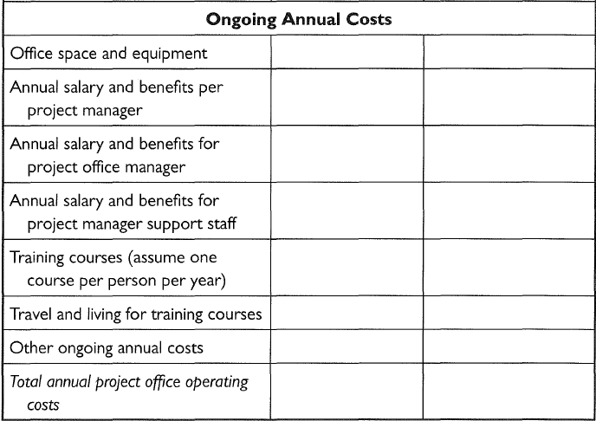
COST OF A PROJECT OFFICE

Slide 7
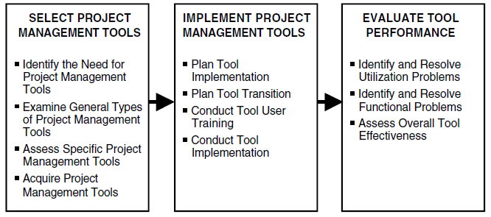
PROJECT MANAGEMENT TOOLS

Slide 8
STANDARDS AND METRICS

Slide 9
PROJECT KNOWLEDGE MANAGEMENT

Slide 10
Organizational Governance
Strategic Planning
Management of Operation
Management by Projects
Portfolio Management
Program Management
Project Management
Processes Tools Metrics

Slide 11
Organizational Context of Portfolio Management
Vision
Mission
Organizational Strategy and Objectives
High-Level Operations Planning and Management
Project Portfolio Planning and Management
Management of On-Going Operations
Management of Authorized Programs and Projects

Slide 12
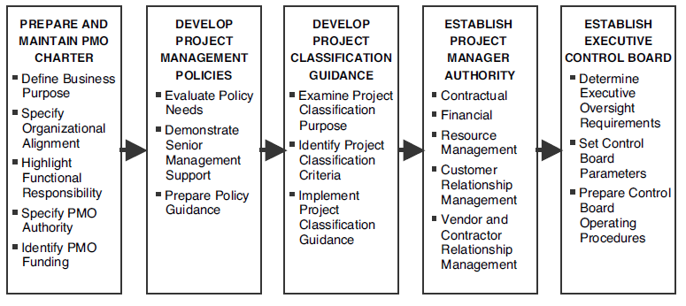
PROJECT GOVERNANCE

Slide 13
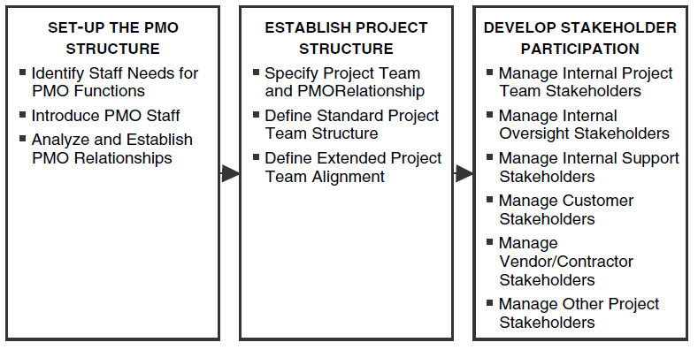
ORGANIZATION AND STRUCTURE

Slide 14
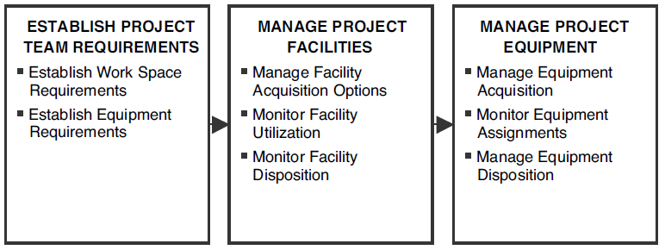
FACILITIES AND EQUIPMENT SUPPORT

Slide 15
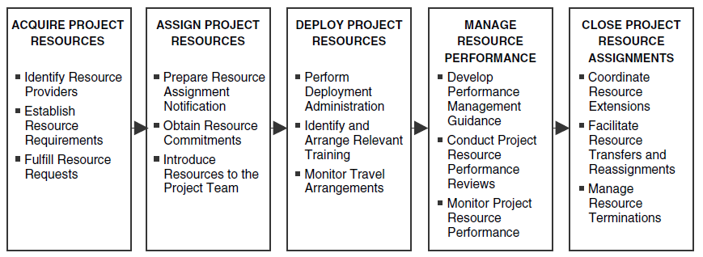
RESOURCE MANAGEMENT

Slide 16
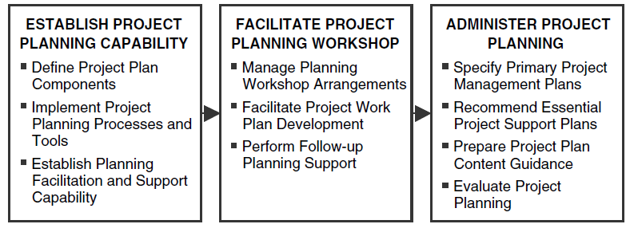
PROJECT PLANNING

Slide 17
PROJECT AUDITING

Slide 18
ASSESSMENT

Slide 19
Cash Flow
Activity | PV | 1 | 2 |  | 3 | 4
A | 50,000
B | 40,000
C | 60,000
D | 30,000
Monthly Indirect Cost |  | 5,000 | 5,000 |  | 5,000 | 5,000

Slide 20
Cash Flow
A | 50,000
B | 40,000
C | 60,000
D | 30,000
Monthly Direct Cost |  | 25,000 | 65,000 |  | 75,000 | 15,000
Monthly Indirect Cost |  | 5,000 | 5,000 |  | 5,000 | 5,000
Total Monthly Cost |  | 30,000 | 70,000 |  | 80,000 | 20,000
Cumulative Monthly Cost |  | 30,000 | 100,000 |  | 180,000 | 200,000

Slide 21
Cash Flow
A | 50,000
B | 40,000
C | 60,000
D | 30,000
Monthly Direct Cost |  | 25,000 | 65,000 |  | 75,000 | 15,000
Monthly Indirect Cost |  | 5,000 | 5,000 |  | 5,000 | 5,000
Total Monthly Cost |  | 30,000 | 70,000 |  | 80,000 | 20,000
Cumulative Monthly Cost |  | 30,000 | 100,000 |  | 180,000 | 200,000

Slide 22
2-month progress
Activity | PV | 1 | 2 |  | 3 | 4 | % Complete | AC
A | 50,000 |  |  |  |  |  | 100 | 55,000
B | 40,000 |  |  |  |  |  | 60 | 28,000
C | 60,000 |  |  |  |  |  | 40 | 22,000
D | 30,000 |  |  |  |  |  | 10 | 4,000
Monthly Indirect Cost |  | 5,000 | 5,000 |  | 5,000 | 5,000 |  | 10,000
 |  |  |  |  |  |  |  | 119,000

Slide 23
Cash Flow
Activity | PV | 1 | 2 |  | 3 | 4 | % Complete | EV
A | 50,000 |  |  |  |  |  | 100 | 50,000
B | 40,000 |  |  |  |  |  | 60 | 24,000
C | 60,000 |  |  |  |  |  | 40 | 24,000
D | 30,000 |  |  |  |  |  | 10 | 3,000
Direct EV |  |  |  |  |  |  |  | 101,000
Total EV |  |  |  |  |  |  |  | 112,222

Slide 24
Performance Report
PV =100,000
EV= 112,222
AC=119,000
SV = 112,222 – 100,000 = 12,222
SPI = 112,222 /100,000 = 1.12
CV = 112,222 – 119,000 = -6,778
CPI = 112,222 /119,000=0.943

Slide 25
PROJECT PORTFOLIO MANAGEMENT

Slide 26
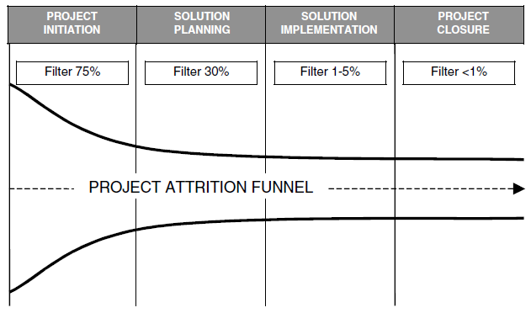
PROJECT ATTRITION

Slide 27
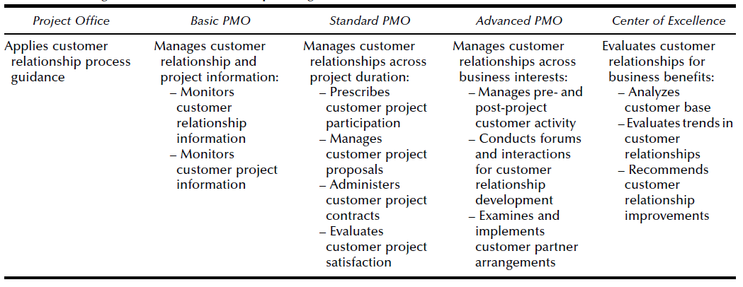
CUSTOMER RELATIONSHIP MANAGEMENT ACTIVITIES

Slide 28
CUSTOMER RELATIONSHIP MANAGEMENT

Slide 29
Project Performance

Slide 30
PERFORMANCE VARIANCE

Slide 31
BENEFITS REALIZATION

Slide 32
SCORING COMPONENT PERFORMANCE

Slide 33
CHANGES IN THE WEIGHTING FOR SCORING PERFORMANCE

Slide 34
PORTFOLIO EFFICIENT FRONTIER

Slide 35
OUTCOME PROBABILITY ANALYSIS

Slide 36
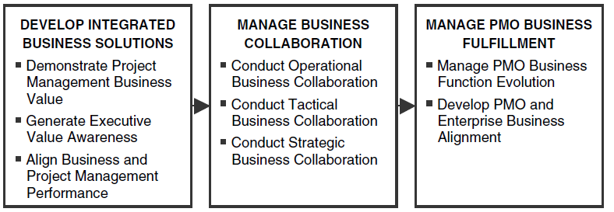
Business Performance Management

Slide 37
PMO Implementation
Perform General Services
Report Activities
Implement and evaluate Methodology
Promote Standards
Improve Processes
Support Software
Update Plans
Maintain Knowledge Base

Slide 38
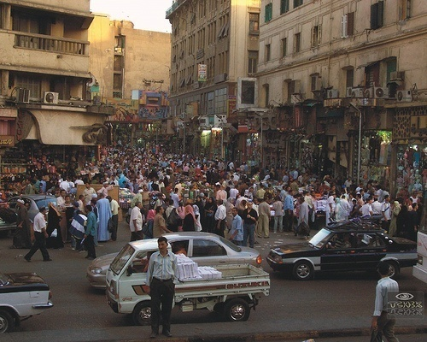
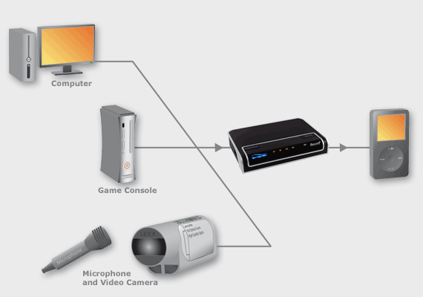
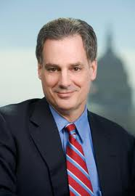
Communication Model
Encode
Decode
Ideas, facts, suggestions
Ideas, facts, suggestions
Noise
Feedback

Slide 39
Communication Directions
Upward channel
Communicate to senior executives
Highlight issues, risks, and exceptions
Status reports, exception reports, charter, reviews, communication plan
Lateral channel
Communicate to client, vendors, functional managers
Negotiation for resources, budgets, time
Communication plan, SOW, contracts, e-mail
Diplomacy and tact
Provide direction to team
Highlight task pending, scheduled tasks, dates, team briefing
Verbal , agendas, minutes, e-mail, briefs, plans, issue logs
Delegation skills
Downward channel

Slide 40
PORTFOLIO COMMUNICATION MANAGEMENT

Slide 41
COMMUNICATION STRATEGY MATRIX

Slide 42
STAKEHOLDER MATRIX

Slide 43
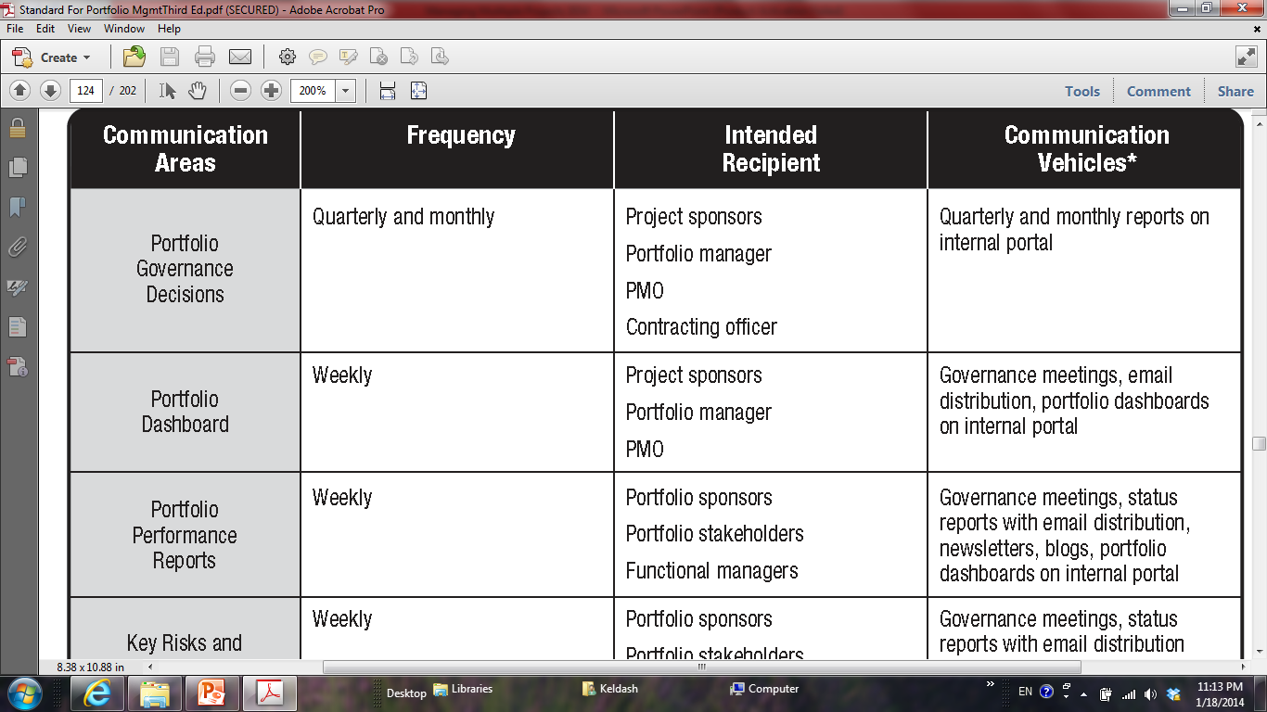
COMMUNICATION MATRIX

Slide 44
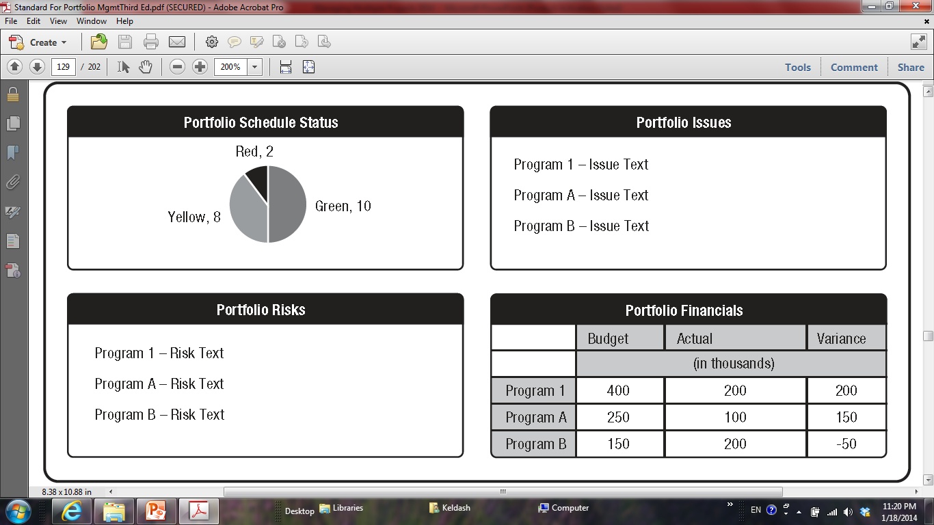
DASHBOARD

Slide 45
Risk Responsibility Chart
 | Top management | PM | Management Team | Risk Owner
Plan Risk Management | X | X | X
Identify Risk |  | X | X
Perform Qualitative Risk Management |  | X | X | X
Perform Qualitative Risk Management |  | X | X | X
Plan Risk Responses |  | X | X | X
Monitor & Control Risks |  | X | X | X

Slide 46
Risk Breakdown Structure (RBS)
Project
Technical
Project
Management
Organizational
External
Others
Quality
Time
Objectives
Weather
Performance
Cost
Fund
Labor
Complexity
Resource
Collaboration
Politics

Slide 47
PORTFOLIO RISK CATEGORIZATION

Slide 48
Likelihood Expectations
Level | Likelihood | Expected or actual frequency experienced
1 | Rare | May only occur in exceptional circumstances; simple process; no previous incidence of non-compliance
2 | Unlikely | Could occur at some time; less than 25% chance of occurring; noncomplex process &/or existence of checks and balances
3 | Possible | Might occur at some time; 25 –50% chance of occurring; previous audits/reports indicate non-compliance; complex process with extensive checks & balances; impacting factors outside control of organization
4 | Likely | Will probably occur in most circumstances; 50-75% chance of occurring; complex process with some checks & balances; impacting factors outside control of organization
5 | Almost certain | Can be expected to occur in most circumstances; more than 75% chance of occurring; complex process with minimal checks & balances; impacting factors outside control of organization

Slide 49
Impact Scale
 | Relative or numerical scales
Objective | Very low / 0.05 | Low / 0.10 | Moderate / 0.20 | High / 0.40 | Very High / 0.80
Cost | Insignificant increase | <10% increase | 10-20% increase | 20-40% increase | >40% increase
Time | Insignificant increase | <5% increase | 5-10% increase | 10-20% increase | >20% increase
Scope | Barely noticed change | Minor change | Major change | Unacceptable by sponsor | Product is useless
Quality | Barely noticed | Applications affected | Sponsor approval required | Unacceptable by sponsor | Product is useless

Slide 50
Stakeholder Tolerance Matrix
Stakeholder | Requirements | Tolerances
 |  | Time | Cost | Quality
PM | Deliver product as requested | More than 10% Phase II | More than 5% Phase II | Conformance to all specs
Technical Manager | Passing all QC criteria | More than 20% Phase II | More than 10% Phase II | Conformance to all limitations
Marketing Manager | Verify profits | More than 5% Phase II | More than 2% Phase II | Customer acceptance
IT Manager | Customer satisfaction (internal & external) | More than 20% Phase II | More than 5% Phase II | Positive feedback

Slide 51
Risk Matrix
 | Consequences
Likelihood | Insignificant | Minor | Moderate | Major | Extreme
Rare | Low | Low | Low | Low | Low
Unlikely | Low | Low | Low | Medium | Medium
Possible | Low | Low | Medium | Medium | Medium
Likely | Low | Medium | Medium | High | High
Almost certain | Low | Medium | Medium | High | Extreme

Slide 52
Cause & Effect
Labor
Productivity
Scope
Delay in Project
Funding
Materials
Management

Slide 53
SWOT
 | PRO | CON
Internal | Strength | Weakness
External | Opportunity | Threat

Slide 54
Risk Register
Task | Cause | Risk | Effect
Design | Conflict | Errors + Rework | Delay
Procurement | Single supplier | Inappropriate delivery | Delay / cost increase
Handing out | Permit not ready | No access | Delay
Executing | Technical problems | Rework | Delay / Cost increase
Verification | Nonconformance | Corrective action | Quality / Cost/ Time

Slide 55
Probability – Impact Matrix
Impact | 0.9 | 0.7 | 0.5 | 0.3 | 0.1
Probability
0.9 | 0.81 | 0.63 | 0.45 | 0.27 | 0.09
0.7 | 0.63 | 0.49 | 0.35 | 0.21 | 0.07
0.5 | 0.45 | 0.35 | 0.25 | 0.15 | 0.05
0.3 | 0.27 | 0.21 | 0.15 | 0.09 | 0.03
0.1 | 0.09 | 0.07 | 0.05 | 0.03 | 0.01

Slide 56
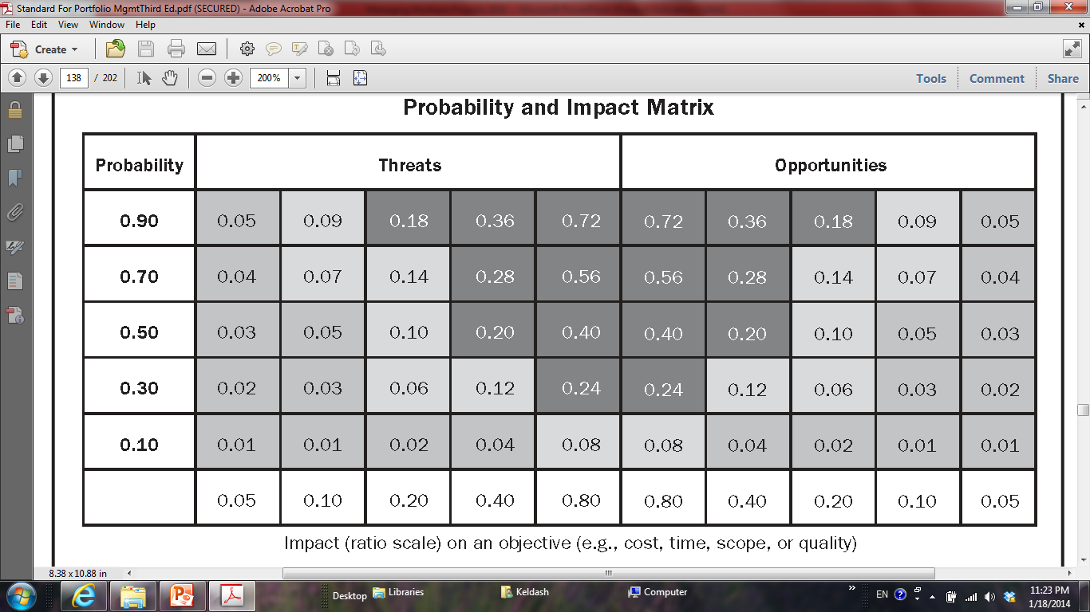
PROBABILITY – IMPACT MATRIX

Slide 57
Probability – Impact Chart
High probability
Low probability
Low impact
High impact

Slide 58
Critical Events
High severity
Low severity
High urgency
Low urgency

Slide 60
SENSITIVITY ANALYSIS
Inflation
Currency
Discount rate
Market demand
Conformance
-$2M
-$1M
$0M
+$1M
+$2M
Tornado Diagram

